Slide 1

Facial Recognition
Have you noticed that Facebook has developed an uncanny ability to recognize your friends in your photographs?
In the old days, Facebook used to make you to tag your friends in photos by clicking on them and typing in their name. Now as soon as you upload a photo, Facebook tags everyone for you like magic

Slide 2
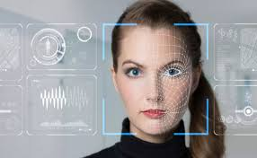
What is facial Recognition
Facial recognition is a way of identifying or confirming an individual’s identity using their face.
How Facial Recognition is Used:
Unlocking phones
Law enforcement
Airports and border control
Finding missing persons
Banking
Marketing and advertising
Healthcare
Tracking student or worker attendance

Slide 3
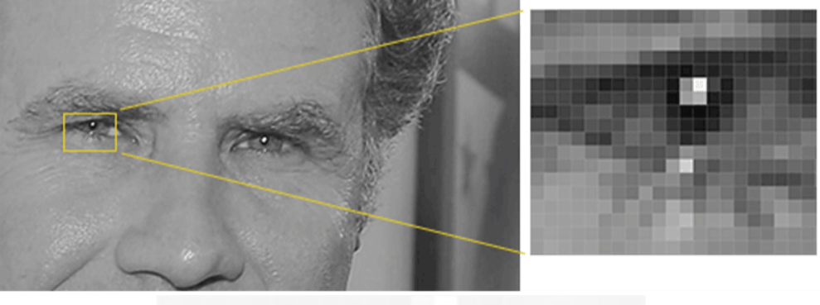
How facial Recognition Works
Step 1:Face Detection:
We’re going to use a method invented in 2005 called Histogram of Oriented Gradients — or just HOG for short.
we’ll start by making our image black and white.
Then we’ll look at every single pixel in our image one at a time. For every single pixel, we want to look at the pixels that directly surrounding it:

Slide 4
The original image is turned into a HOG representation that captures the major features of the image regardless of image brightnesss.
To find faces in this HOG image, all we have to do is find the part of our image that looks the most similar to a known HOG pattern that was extracted from a bunch of other training faces.

Slide 5
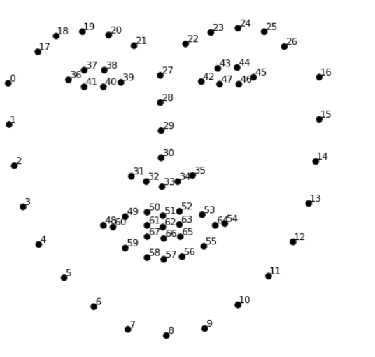
Step 2:Posing and Projecting Faces
we are going to use an algorithm called face landmark estimation.
The basic idea is we will come up with 68 specific points(called landmarks) that exists on every face. Then we will train a machine learning algorithm to be able to find these specific points on any face.
Now that we know were the eyes and mouth are, we’ll simply rotate, scale and shear the image so that the eyes and mouth are centered as best as possible.

Slide 6
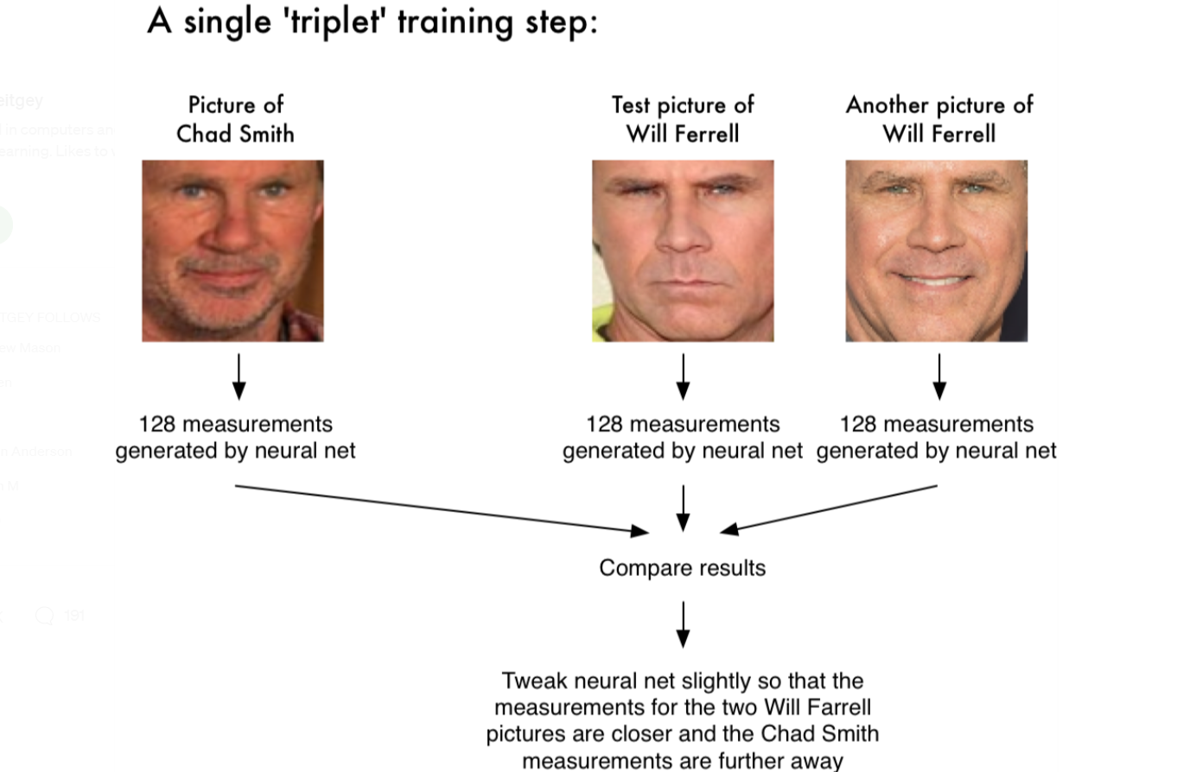
Step 3: Encoding Faces
Researchers have discovered that the most accurate approach is to let the computer figure out the measurements to collect itself. Deep learning does a better job than humans at figuring out which parts of a face are important to measure.
After repeating this step millions of times for millions of images of thousands of different people, the neural network learns to reliably generate 128 measurements for each person.

Slide 7
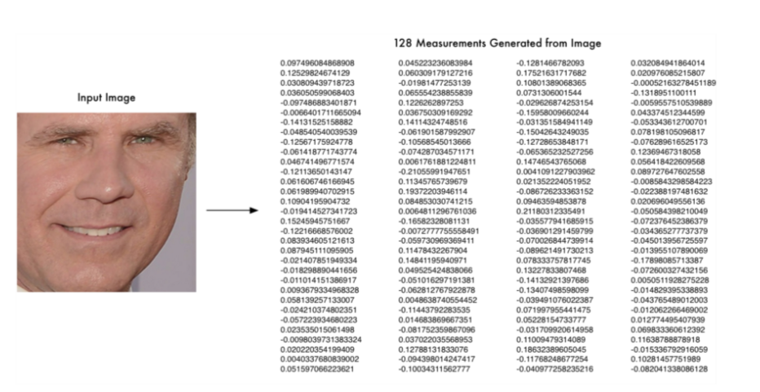
But once the network has been trained, it can generate measurements for any face, even ones it has never seen before!
So, all we need to do ourselves is run our face images through the pre-trained network to get 128 measurements of each face.
Surprisingly, we don’t know what are these 128 measurements
exactly but what is known was different pictures of the person given will
return almost the same set of values.

Slide 8
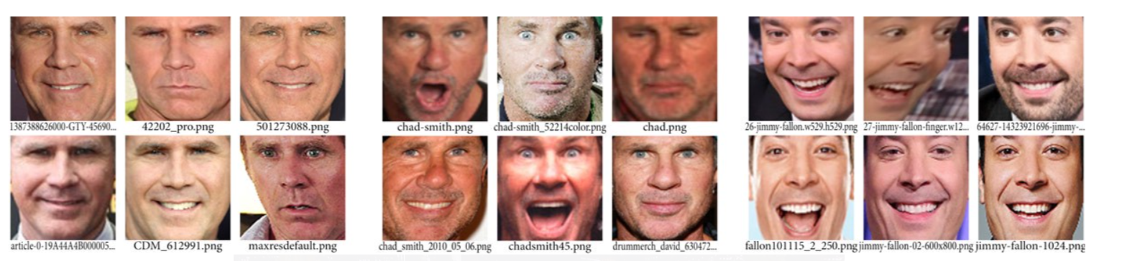
Step 4: Finding the person’s name from the encoding.
This last step is actually the easiest step in the whole process. All we have to do is find the person in our database of known people who has the closest measurements to our test image.
You can do that by using any basic machine learning classification algorithm. Here it is linear SVM Classifier.
All we need to do is train a classifier that can take in the measurements from a new test image and tells which known person is the closest match.

